Slide 1
Network Architecture Search and MNN

Slide 2
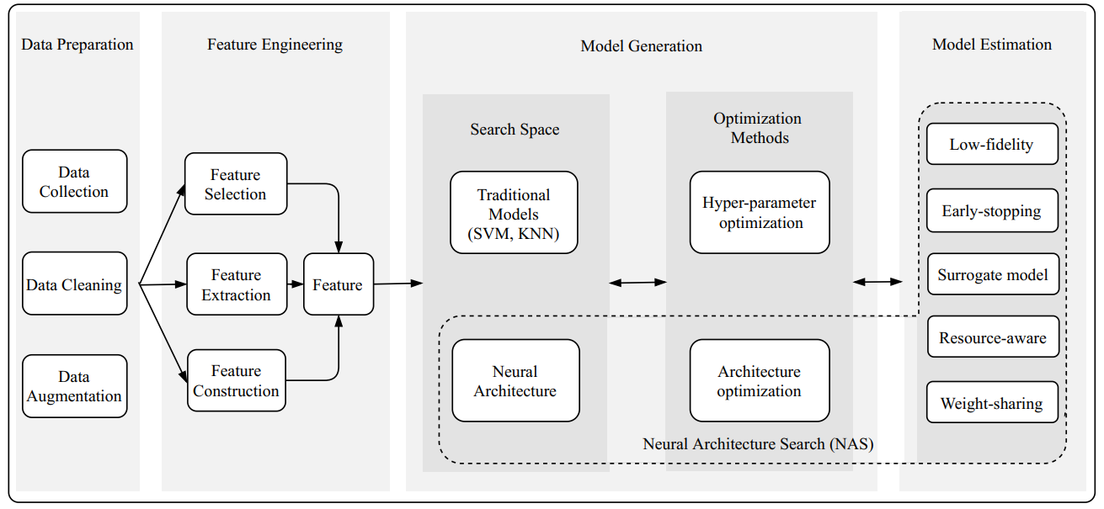
AutoML Intro^{[1]}
Building a high-quality DL system for a specific task highly relies on human expertise. => Automated machine learning (AutoML) becomes a promising solution to build a DL system without human assistance.

Slide 3
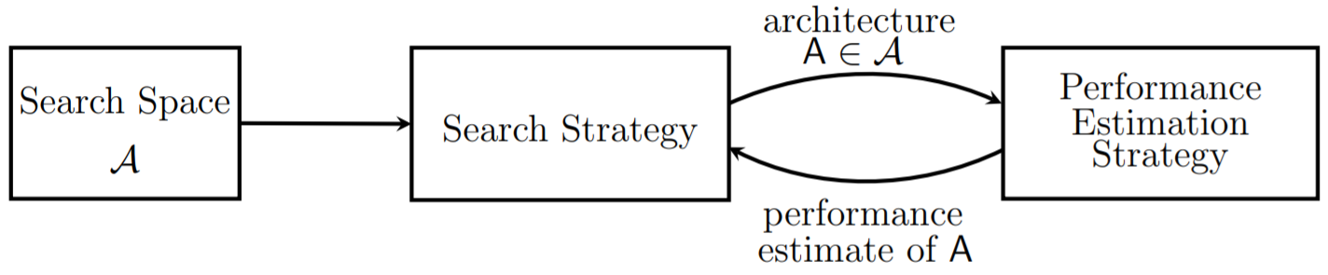
Neural Architecture Search^{[2]}
Search space: defines a set of operations and how operations can be connected to form valid network architectures. usually involves human expertise, as well as unavoidably human biases.
Search algorithm: samples a population of network architecture candidates. It receives the child model performance metrics as rewards (e.g. high accuracy, low latency) and optimizes to generate high-performance architecture candidates.
Evaluation strategy: to measure, estimate, or predict the performance of proposed child models in order to obtain feedback for the search algorithm to learn.

Slide 4
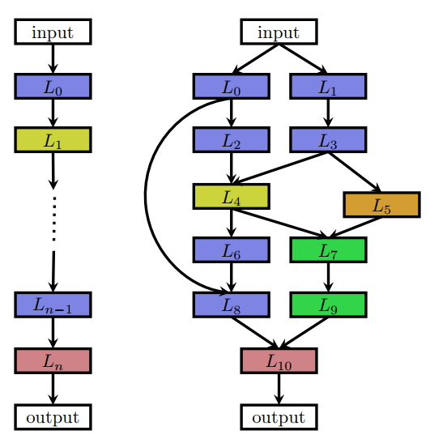
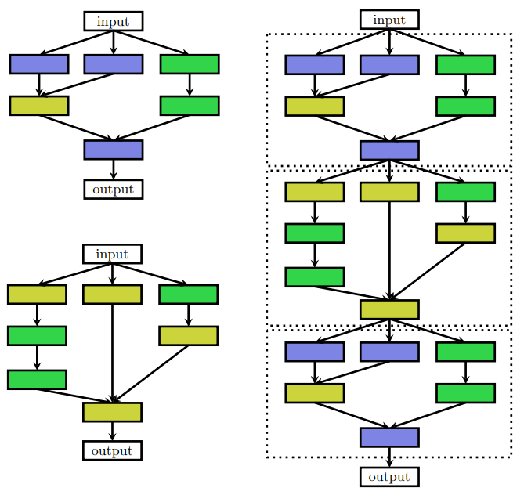
Search Space^{[2]}
Left: Each node in the graphs corresponds to a layer in a neural network.
Right: Two different cells, and an architecture built by stacking the cells sequentially.

Slide 5
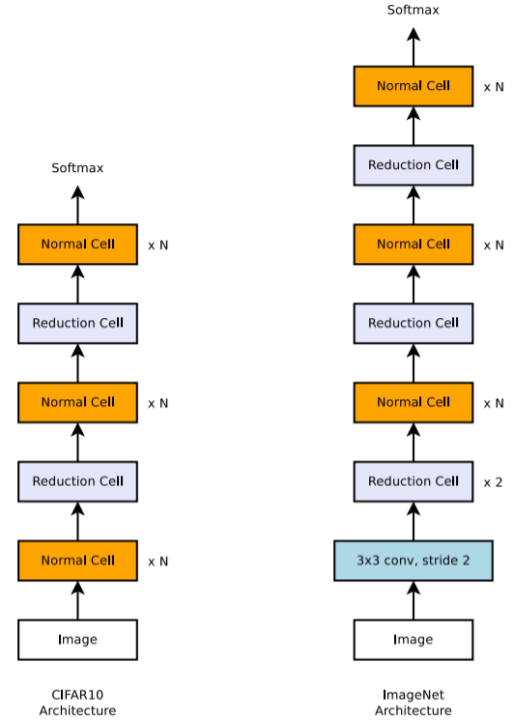
Cell-based Representation^{[3]}
defines the architecture of a conv net as the same cell getting repeated multiple times and each cell contains several operations predicted by the NAS algorithm.
A well-designed cell module enables transferability between datasets. It is also easy to scale down or up the model size by adjusting the number of cell repeats.

Slide 6
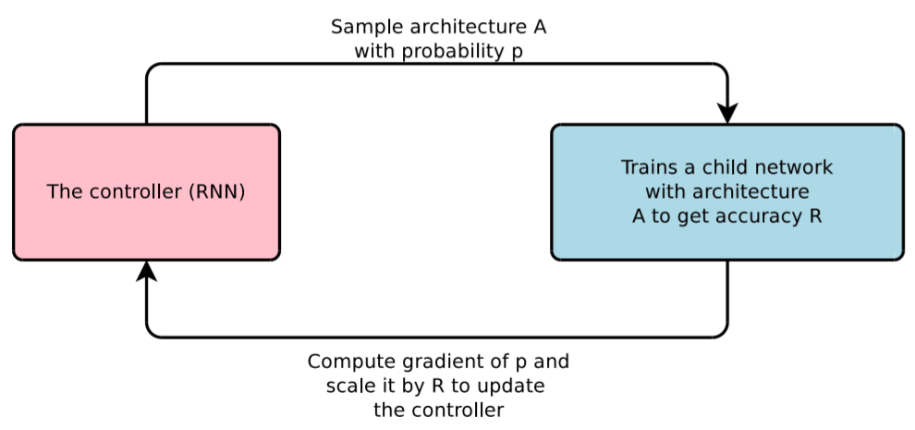
Search Algorithms: Reinforcement Learning^{[4]}
Action space: The action space is a list of tokens for defining a child network predicted by the controller. The controller outputs action, a_{1:T,} where T is the total number of tokens.
Reward: The accuracy of a child network that can be achieved at convergence is the reward for training the controller, R.
Loss: NAS optimizes the controller parameters θ with a REINFORCE loss. maximize the expected reward (high accuracy).

Slide 7
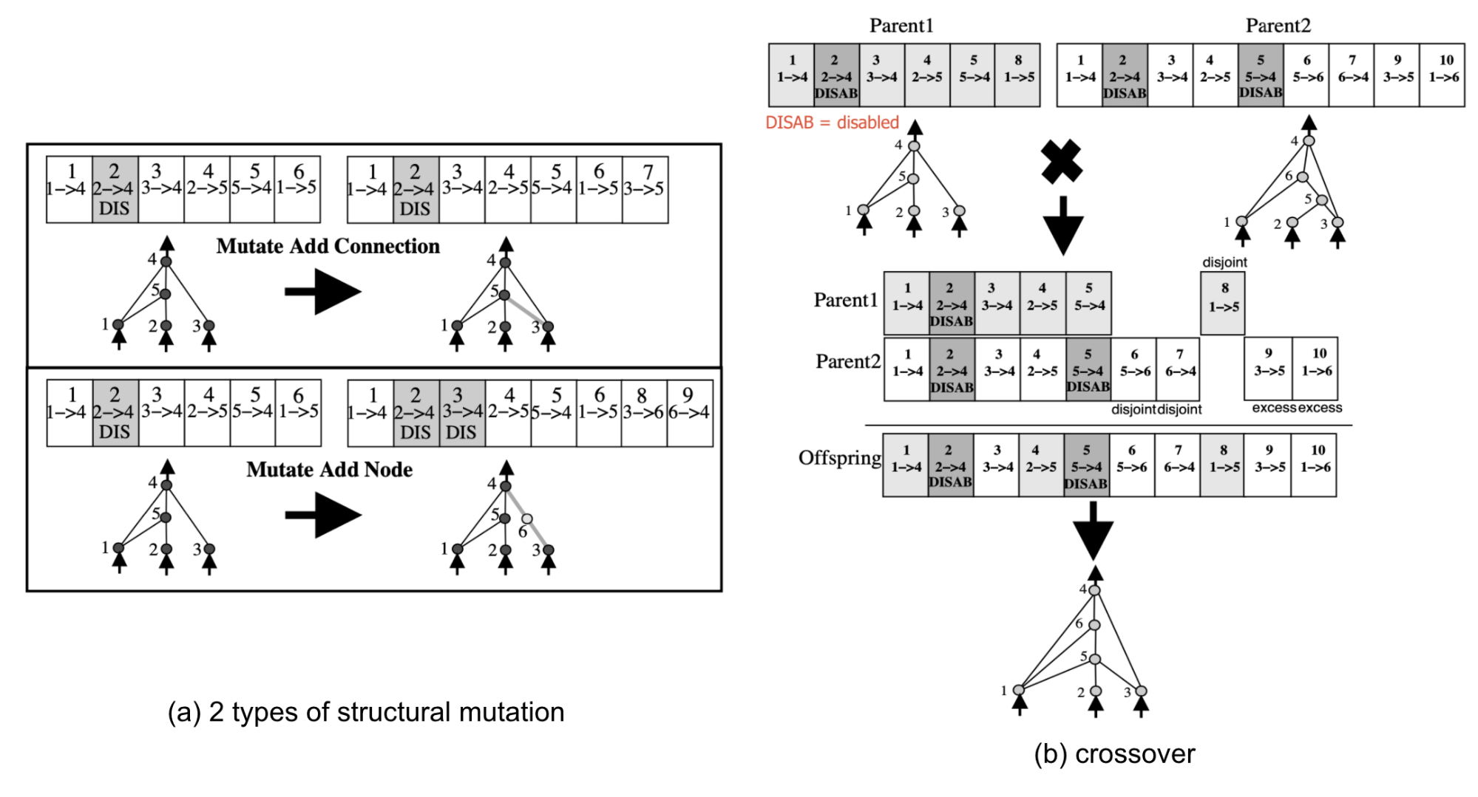
Search Algorithms: Evolutionary Algorithms^{[4]}

Slide 8
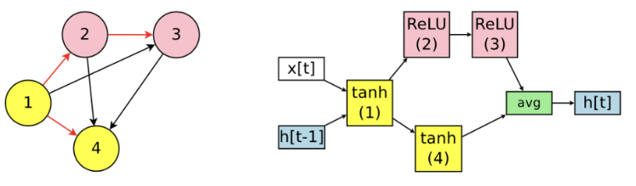
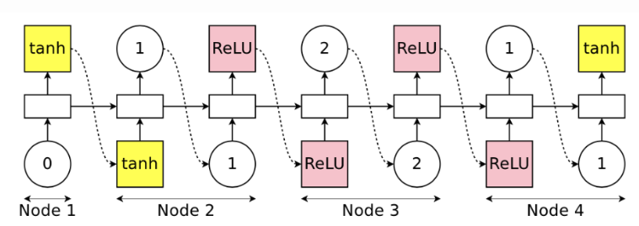
Evaluation strategy: Parameter Sharing^{[4]}
all of the sampled architecture graphs can be viewed as sub-graphs of a larger super-graph. All the child networks are sharing weights of this super-graph.

Slide 9
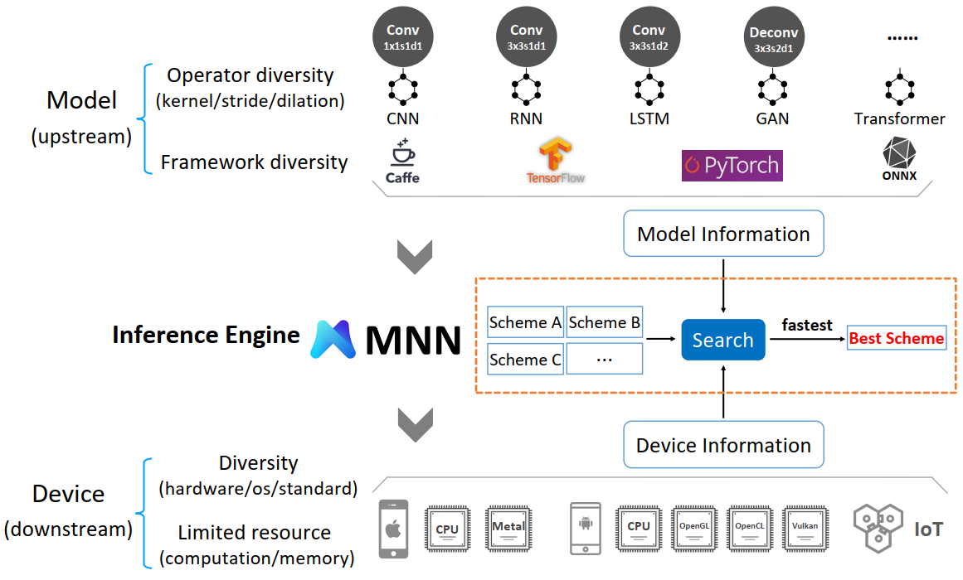
MNN: A UNIVERSAL AND EFFICIENT INFERENCE ENGINE^{[5]}

Slide 10
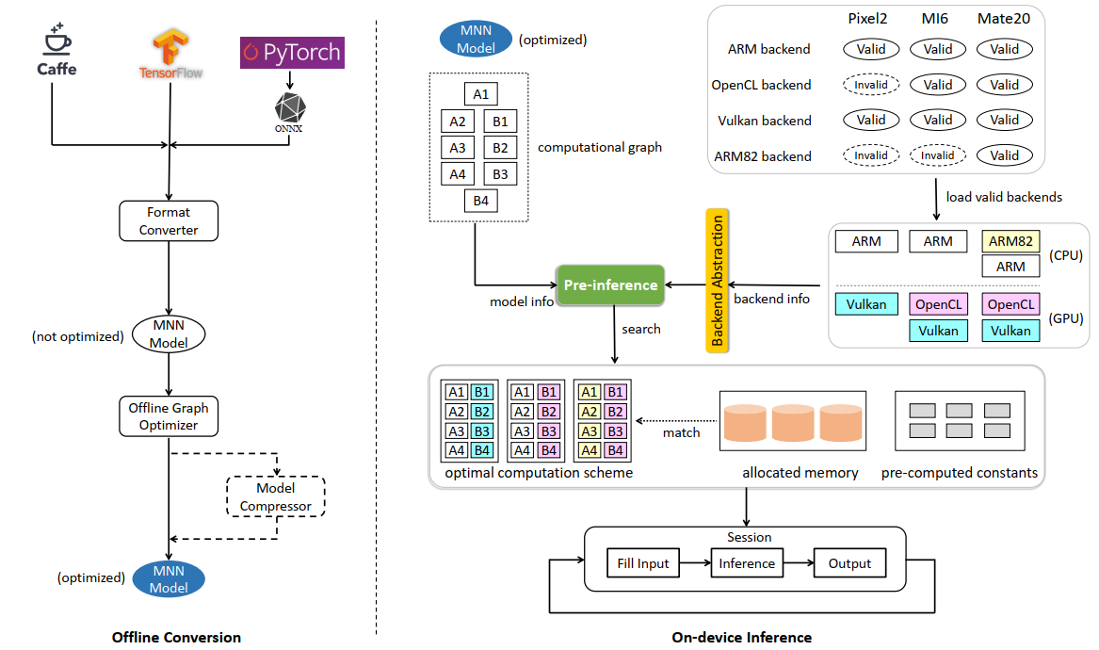

Slide 11
Offline Conversion: the converter first transforms models to MNN model format (.mnn). some basic graph optimizations are performed, such as operator fusion, replacement, and model quantization.
On-device Inference: pre-inference, operator-level optimization, and backend abstraction. For each operator, the pre-inference module offers a cost evaluation mechanism, which combines the information (e.g., input size, kernel shape) with backend properties (e.g., number of cores, hardware availability) to dynamically determine the optimal computation solution from a solution pool. Then the operator-level optimization module utilizes advanced algorithms together with techniques like SIMD (Single Instruction Multiple Data), pipelining to further boost the performance.

Slide 12


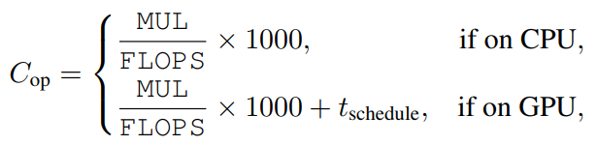
Pre-inference
some optimization techniques like memory pre-allocation and reuse can be conducted to further improve the performance.
Computation scheme selection takes into consideration both the algorithm implementation and the backend characteristics:
T_{schedule} accounts for the cost to prepare the command buffer and command description for GPU

Slide 13
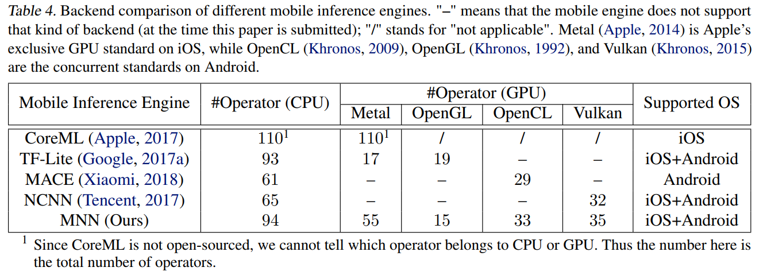
Evaluation
For iOS, adopt iPhone8 and iPhoneX (processor: Apple A11 Bionic). For Android, MI6 (processor: Snapdragon 835) and Mate20 (processor: Kirin 980) are adopted.

Slide 14
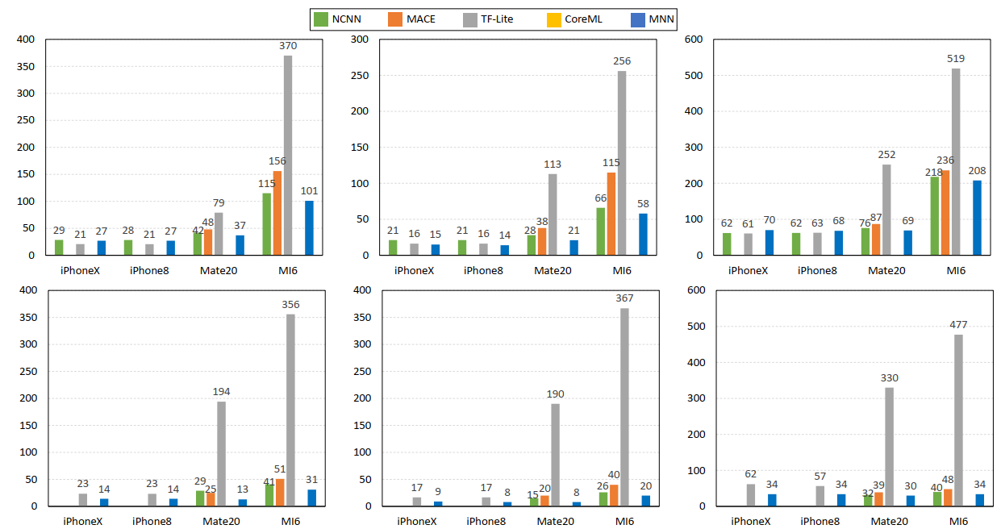
CPU {2,4} threads

Slide 15
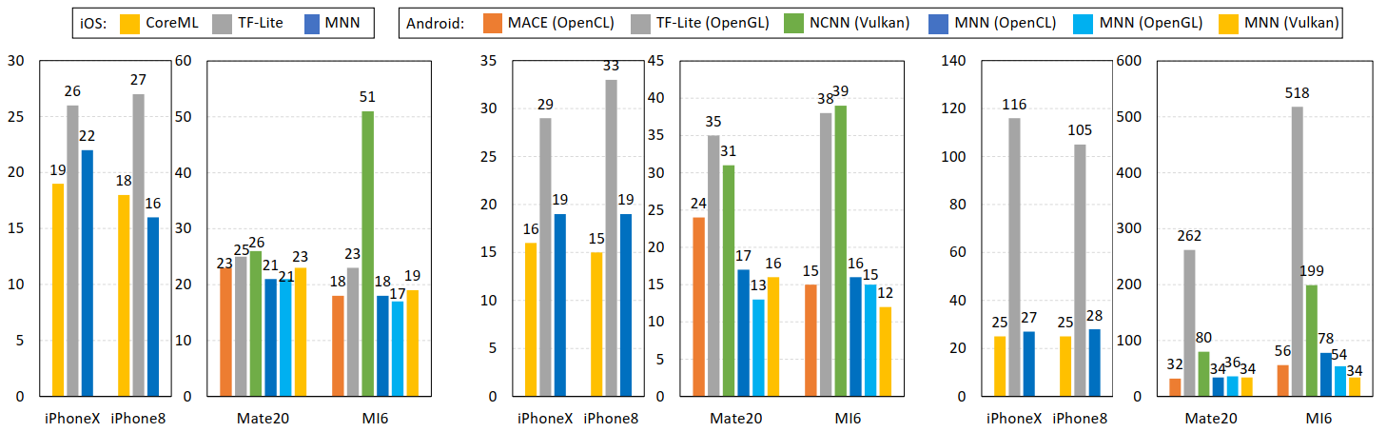
GPU
The multi-thread CPU inference using MNN on high-end devices (e.g., iPhone8 and iPhoneX) is highly competitive compared with that using GPU backends.

Slide 16
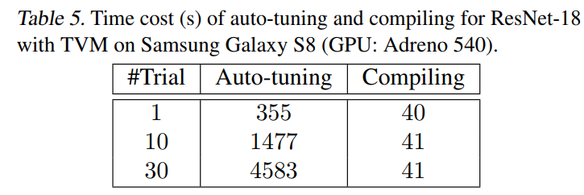
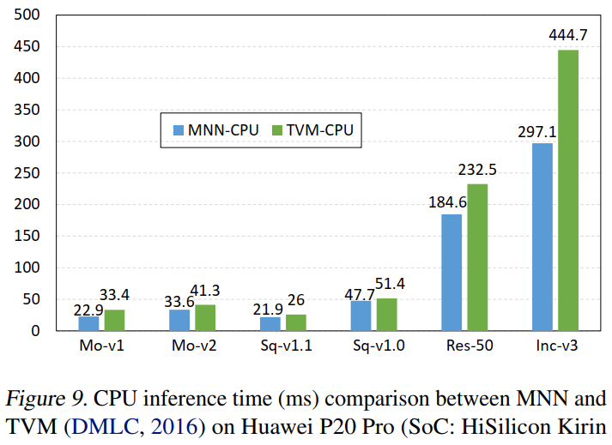
Compared with TVM
Even with a small number of trials for tuning on a single device, TVM still takes much time to generate code.
MNN is free from these issues because all optimizations are performed at runtime without performance loss.

Slide 17
References
[1] https://marsggbo.github.io/automl_a_survey_of_state_of_the_art/
[2] https://arxiv.org/pdf/1808.05377.pdf
[3] https://arxiv.org/pdf/1707.07012.pdf
[4] https://lilianweng.github.io/lil-log/2020/08/06/neural-architecture-search.html
[5] https://proceedings.mlsys.org/static/paper_files/mlsys/2020/7-Paper.pdf

